Slide 1
WEKA Dataset, Classifier And J48 Algorithm For Decision Tree for iris.arff dataset
Course Project by :-
John Nixon 2gi19is016
Hrutuja patnekar 2gi19is017

Slide 2
Contents
Introduction to WEKA
About iris data-set
Procedure
Working model
Conclusion

Slide 3
Introduction to weka
Waikato Environment for Knowledge Analysis(WEKA) is a tool built on java which has library of machine learning algorithms to solve data mining problems on real data. WEKA also provides an environment to develop many machine learning algorithms. It has a set of tools for carrying out various data mining tasks such as data classification, data clustering, regression, attribute selection, frequent itemset mining, and so on.

Slide 4
About iris data set
This dataset is used for pattern recognition. The data set contains 3 classes of 50 instances. Each class represents a type of iris plant. One class is linearly separable from the other 2 but the latter are not linearly separable from each other. It predicts to which species of the 3 iris flowers the observation belongs. This is called a multi-class classification dataset. Attributes: It has 4 numeric, predictive attributes, and the class. There are no missing attributes.
The attributes are:
• sepal length in cm
• sepal width in cm
• petal length in cm
• petal width in cm
• class: (Iris Setosa, Iris Versicolour, Iris Virginica)

Slide 5
procedure
J48 Classifier: It is an algorithm to generate a decision tree that is generated by C4.5 (an extension of ID3). It is also known as a statistical classifier. For decision tree classification, we need a dataset.
Steps
Open WEKA explorer
Select iris.arff file from the “choose file” under the preprocess tab option.
Go to the “Classify” tab for classifying the unclassified data. Click on the “Choose” button. From this, select “trees -> J48”
Click on Start Button. The classifier output will be seen on the Right-hand panel.
To visualize the tree, right-click on the result and select visualize the tree.

Slide 6
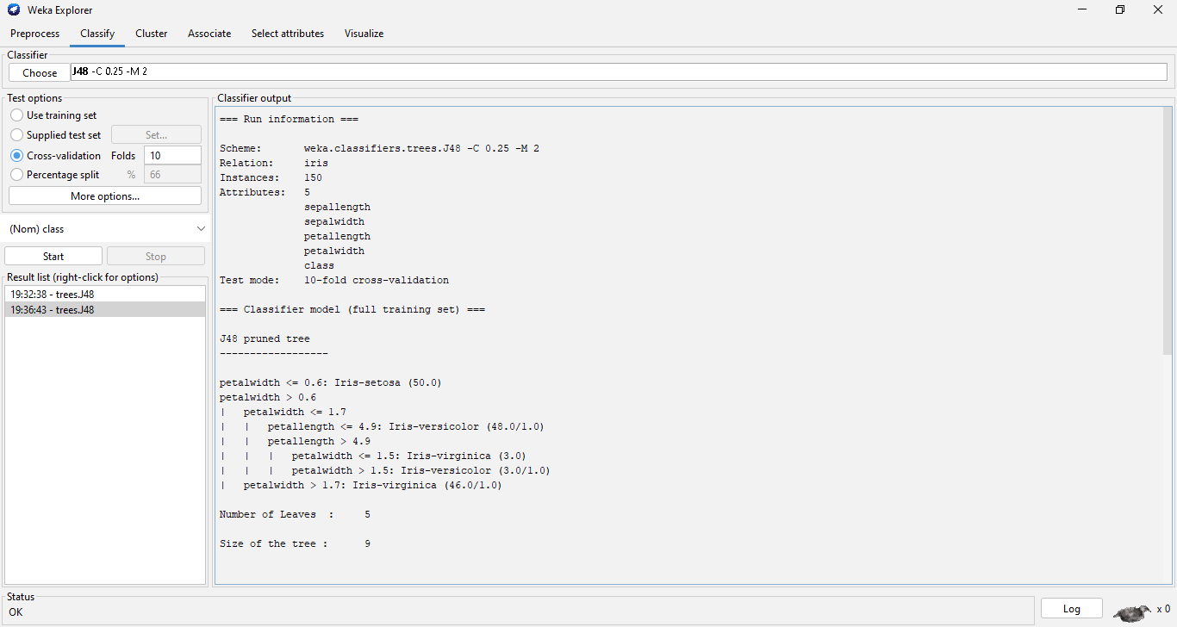
Working model outputs

Slide 7
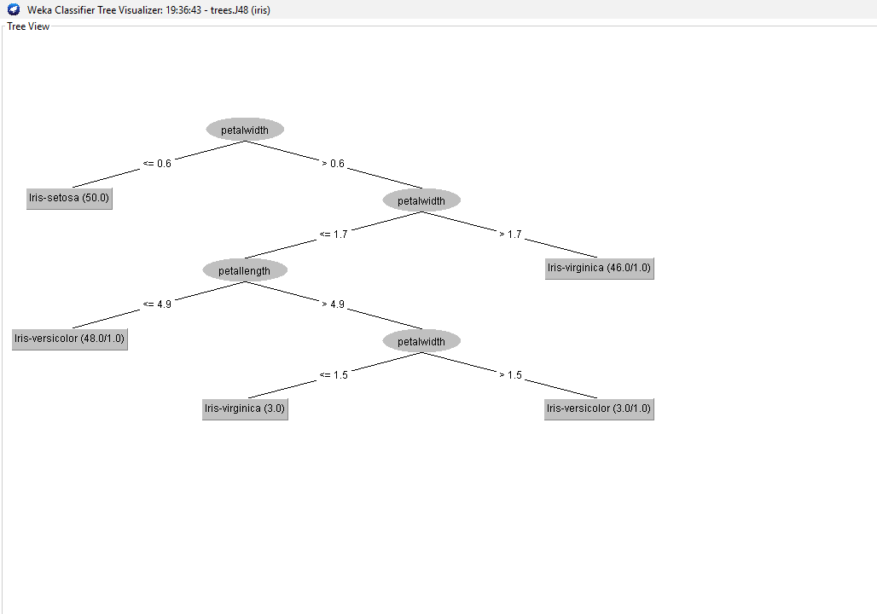

Slide 8
conclusion
WEKA offers a wide range of sample datasets to apply machine learning algorithms. The users can perform machine learning tasks such as classification, regression, attribute selection, and association on these sample datasets, and can also learn the tool using them
WEKA explorer is used for performing several functions, starting from preprocessing. Preprocessing takes input as a .arff file, processes the input, and gives an output that can be used by other computer programs

